Slide 1
LOAN PREDICTION SYSTEM

Slide 2
OUTLINE
INTRODUCTION
PROBLEM DEFINITION
METHODOLOGY
DATASET COLLECTION
FEATURE SELECTION
CLASSIFIERS USED
RESULTS AND ANALYSIS
LOAN PREDICTION SYSTEM
CONCLUSION
FUTURE WORKS
REFERENCES

Slide 3
INTRODUCTION
With the enhancement in the banking sector lots of people are applying for bank loans but the bank has its limited assets which it has to grant to limited people only, so finding out to whom the loan can be granted which will be a safer option for the bank is a typical process. So, in this paper we try to reduce this risk factor behind selecting the safe person so as to save lots of bank efforts and assets. This is done by mining the Big Data of the previous records of the people to whom the loan was granted before and on the basis of these records/experiences the machine was trained using the machine learning model which give the most accurate result. The main objective of this paper is to predict whether assigning the loan to particular person will be safe or not. This paper is divided into four sections (i)Data Collection (ii) Comparison of machine learning models on collected data (iii) Training of system on most promising model (iv) Testing Keywords - Loan, Machine Learning, Training, Testing, Prediction.

Slide 4
PROBLEM DEFINITION
Collecting dataset of loan from Kaggle site.
Then we fix the value of input and output to the X and y variable selecting the specific column of the dataset.
Then after splitting the dataset into train and test model for 80% and 20% we use label encoder for converting the dataset from categorical to numerical.
After converting we use 5 machine learning methods for detecting the highest accuracy for the problem. And in this case Logistic regression has the highest accuracy.
Then describing f_score, precision, recall. Then plotting the accuracy, precision, recall, f_score through seaborn.
Using HTML and CSS we create the GUI for (the interface) loan prediction system and connect the interface through flask method.
In interface there are two part of interface, one is home page and second one in which the result is showing the result page in html.
And then loading the path of the model in the flask method to connect the model to interface and predicting the value as 1 or 0 as fake or real.

Slide 5
SEQUENCE DIAGRAM
DATA
FEATURE SELECTION ON COLLECTED DATA
RESULT AND HOME PAGE WITH FLASK CONNECTION
TRANSFER THE COLLECTED DATA
LOGISTIC REGRESSION
84% ACCURACY

Slide 6
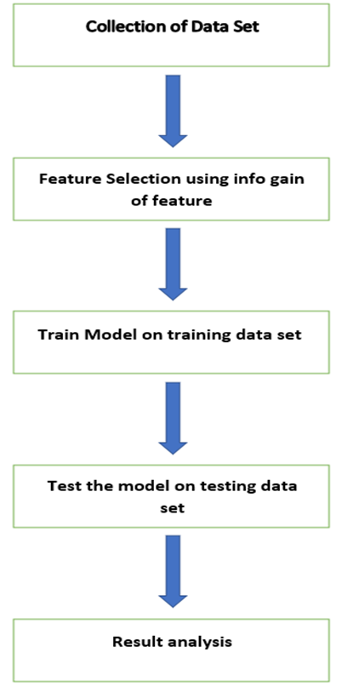
METHODOLOGY
The methodology used in prediction system is problem and data understanding, data filtering, system modelling and finally system evaluation. In this paper a model is built using 5 classifiers and the highest accuracy classifier is taken and trained and tested the model (input and output) based on splitting. Implementing the highest accuracy model classifier Logistic in my case will be better.
After that f_score, recall, precision is calculated. This is quite a analysis part of my project. Now it comes the webpage connection with my model. And it is done using python flask. At first the model is loaded using pathlib library then the home page is created and executed. After that the post method was declared and loaded and saved the model using joblib library. After saving the model then the post method is connected to the html file and executed the post method in machine learning program using python flask request method. Then passed the data entity to array and predicting the loan whether the user is eligible or not.

Slide 7
ACTIVITY DIAGRAM
DATA
FEATURE SELECTION
GENDER
DATA SPLITTING
MARITAL STATUS
ACCURACY
LOAN AMOUNT
WEBPAGE
CREDIT SCORE
ELIGIBLE
IF
FLASK CONNECTION
HOME
PAGE
PROPERTY AREA
RESULT PAGE
NOT ELIGIBLE

Slide 8
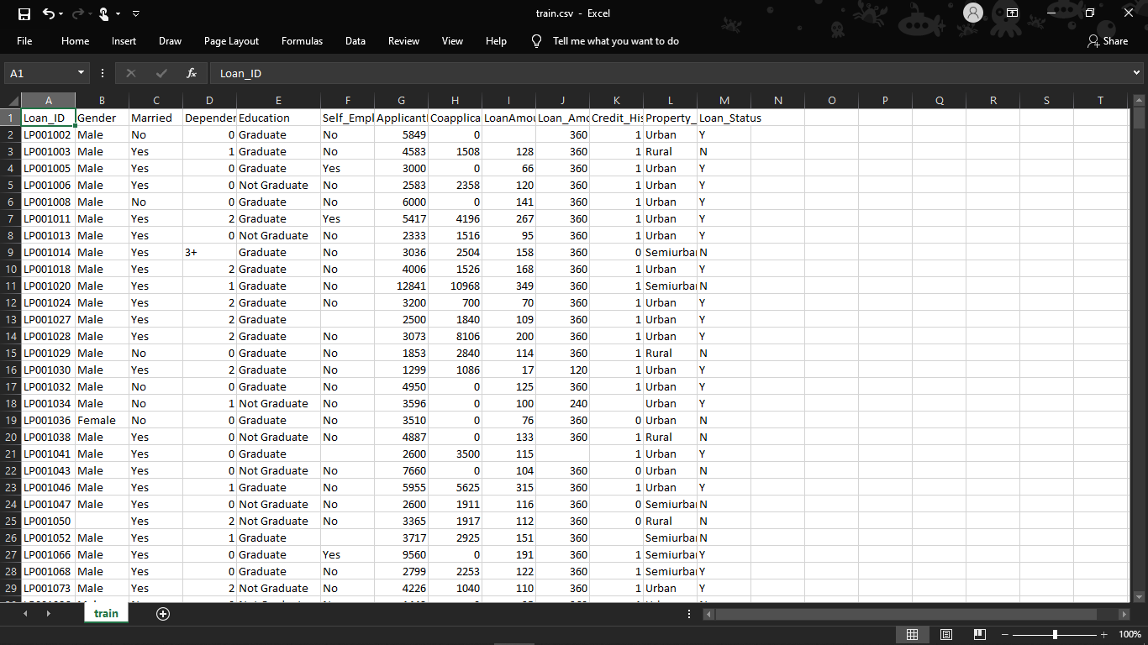
DATA COLLECTION
The dataset was collected from KAGGLE. The required dataset is represented in in the excel sheet below.

Slide 9
FEATURE SELECTION
Based on the correlation among attributes it was observed more likely to pay back their loans. The attributes that are individual and significant can include Property area, education, loan amount, and lastly credit History, which is since by intuition it is considered as important. The correlation among attributes can be identified using corplot and boxplot in Python platform.

Slide 10
CLASSIFIERS USED
6 classifiers are used in my problem for most highest accuracy. They are –
Logistic Regression
Decision Tree
Random Forest
KNN Classifier
K-SVM Classifier
SVM Classifier

Slide 11
CLASSIFIERS
Decision Trees: The basic algorithm of decision tree requires all attributes or features should be discretized. Feature selection is based on greatest information gain of features. The knowledge depicted in decision tree can represented in the form of IF-THEN rules.
KNN Algorithm: K-nearest neighbours (KNN) algorithm is a type of supervised ML algorithm which can be used for both classification as well as regression predictive problems. However, it is mainly used for classification predictive problems in industry.
Random Forest (RF): Random forests are a group learning system for characterization (and relapse) that work by building a large number of Decision trees at preparing time and yielding the class that is the mode of the classes yield by individual trees.
Support Vector Machine (SVM): Support vector machines are administered learning models that uses association r learning algorithm which analyse features and identified pattern knowledge, utilized for application classification. SVM can productively perform a regression utilizing the kernel trick, verifiably mapping their inputs into high-dimensional feature spaces.
Kernel Support Vector Machine (KSVM): The plot function for binary classification ksvm objects displays a contour plot of the decision values with the corresponding support vectors highlighted. The predict function can return class probabilities for classification problems by setting the type parameter to "probabilities".
Logistic Regression: Logistic regression is a statistical model that in its basic form uses a logistic function to model a binary dependent variable, although many more complex extensions exist. In regression analysis, logistic regression (or logit regression) is estimating the parameters of a logistic model (a form of binary regression).

Slide 12
RESULTS AND ANALYSIS
Measurement Matrices:
Accuracy: Accuracy is one metric for evaluating classification models. Informally, accuracy is the fraction of predictions our model got right. Formally, accuracy has the following definition: Accuracy = Number of correct predictions Total number of predictions. In my problem, I used 5 classifiers to get the highest accuracy of all. And in my problem, Logistic regression has the highest accuracy.
Precision: precision (also called positive predictive value) is the fraction of relevant instances among the retrieved instances, It is the number of correct positive by the number of positives. It is “how useful the results are”.
Recall: recall (also known as sensitivity) is the fraction of the total amount of relevant instances It is the number of correct positive by the number of relevant samples (all samples that should have been classified positive). It is “how complete the results are”.
F Score: The F score, also called the F1 score or F measure, is a measure of a test’s accuracy. The F score is defined as the weighted harmonic mean of the test’s precision and recall.

Slide 13
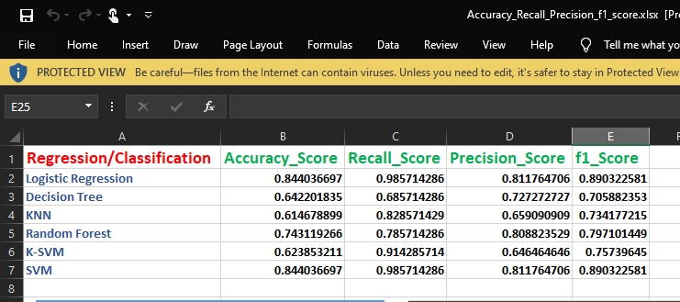
RESULT OF MY PROBLEM
The accuracy, precision, f_score and recall values of my problem is shown below:

Slide 14
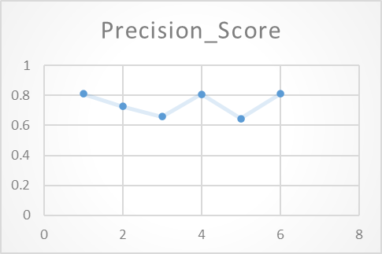
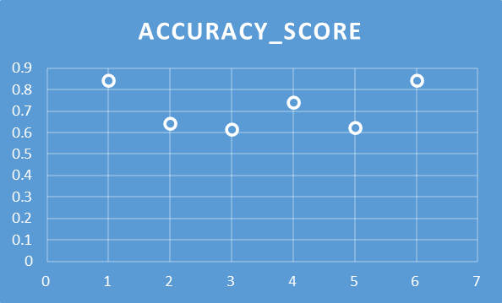
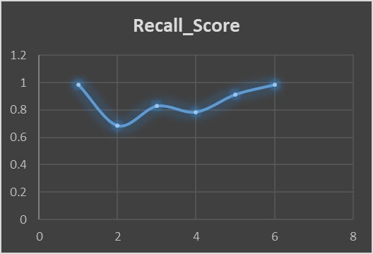
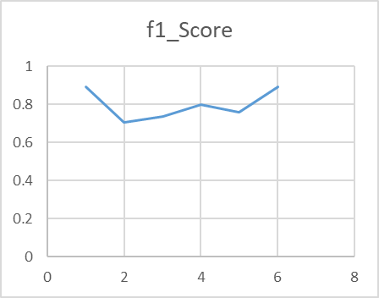
BAR PLOTTING REPRESENTATION OF ACCURACY SCORE, F1_SCORE, PRECISION AND RECALL

Slide 15
LOAN PREDICTION SYSTEM
Distribution of the loans is the core business part of almost every banks. The main portion the bank’s assets is directly came from the profit earned from the loans distributed by the banks. The prime objective in banking environment is to invest their assets in safe hands where it is. Today many banks/financial companies approves loan after a regress process of verification and validation but still there is no surety whether the chosen applicant is the deserving right applicant out of all applicants. Through this system we can predict whether that particular applicant is safe or not and the whole process of validation of features is automated by machine learning technique. The disadvantage of this model is that it emphasize different weights to each factor but in real life sometime loan can be approved on the basis of single strong factor only, which is not possible through this system. Loan Prediction is very helpful for employee of banks as well as for the applicant also. The aim of this Paper is to provide quick, immediate and easy way to choose the deserving applicants. It can provide special advantages to the bank. The Loan Prediction System can automatically calculate the weight of each features taking part in loan processing and on new test data same features are processed with respect to their associated weight .A time limit can be set for the applicant to check whether his/her loan can be sanctioned or not. Loan Prediction System allows jumping to specific application so that it can be check on priority basis. This Paper is exclusively for the managing authority of Bank/finance company, whole process of prediction is done privately no stakeholders would be able to alter the processing. Result against particular Loan Id can be send to various department of banks so that they can take appropriate action on application. This helps all others department to carried out other formalities. So basically our websites contains two Pages one is for taking the input from the user and second one is for predicting the result that whether the user is eligible for the loan or not. There are four input fields which the user has to fill in order to know the result. The four input fields are gender, marital status which is yes or no then loan amount , credit score and the property area.

Slide 16
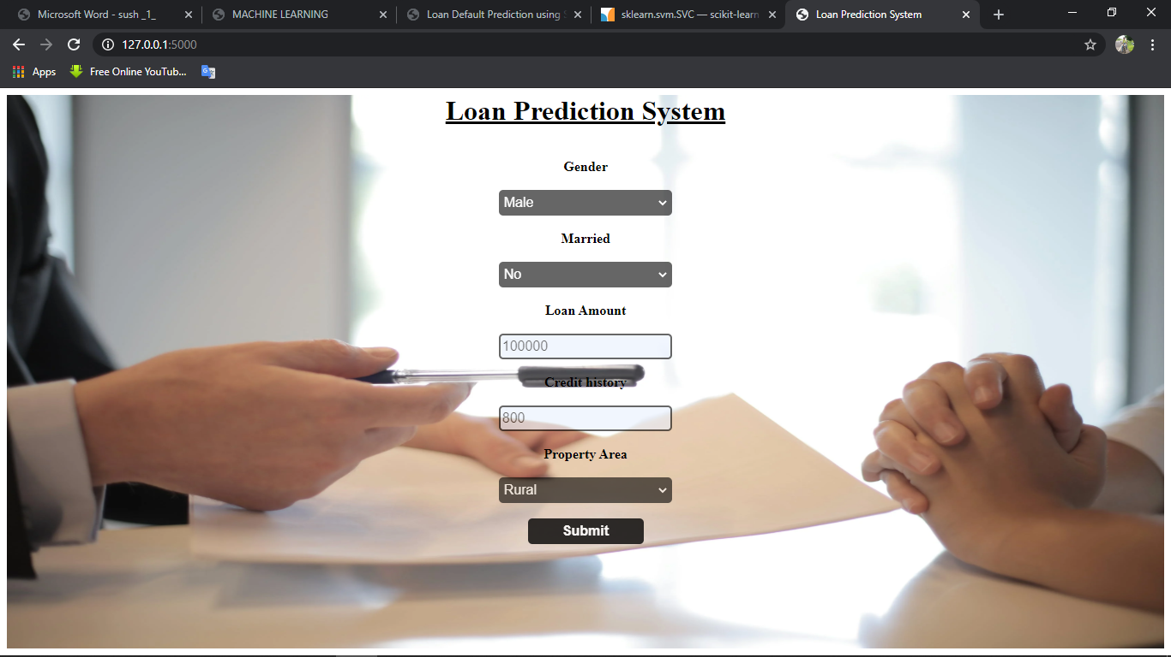
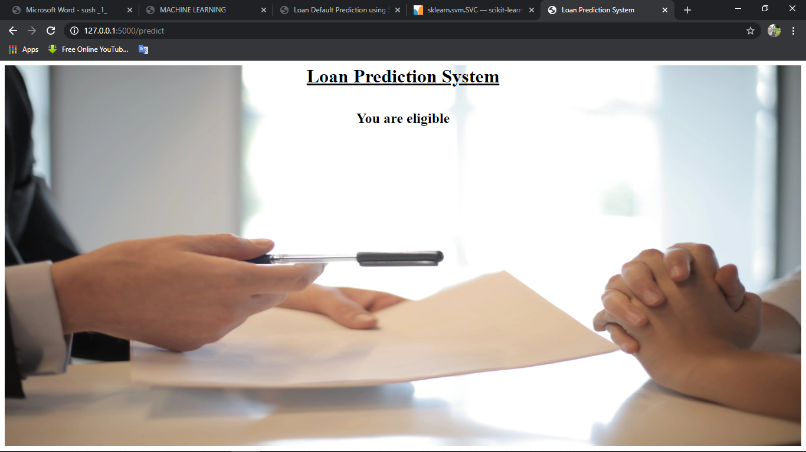
LOAN PREDICTION SYSTEM WEBPAGES

Slide 17
CONCLUSION
From a proper analysis of positive points and constraints on the component, it can be safely concluded that the product is a highly efficient component. This application is working properly and meeting to all Banker requirements. This component can be easily plugged in many other systems.

Slide 18
FUTURE WORKS
There have been numbers cases of computer glitches, errors in content and most important weight of features is fixed in automated prediction system, So in the near future the so –called software could be made more secure, reliable and dynamic weight adjustment .In near future this module of prediction can be integrate with the module of automated processing system. the system is trained on old training dataset in future software can be made such that new testing date should also take part in training data after some fix time.

Slide 19
REFERENCES
https://www.kaggle.com/altruistdelhite04/loan-prediction-problem-dataset
https://towardsdatascience.com/how-to-easily-deploy-machine-learning-models-using-flask-b95af8fe34d4
https://www.geeksforgeeks.org/deploy-machine-learning-model-using-flask/

Slide 20
THANK YOU
PRESENTED BY –
SAYANDIP ADHIKARY
SURAJ SHARMA
TANMOY ADHIKARY
BCA 6TH SEMESTER

